Slide 1
MTG1 HCP meeting
Wednesday 27 November 2024
15:00 – 16:00 CEST
Svetlana Lajic, Nicole Reisch, Manuela Brösamle, Giorgio Dal Maso, Jette Kristensen, Alessandro Lazzerini, Zuzana Smith
MTG1 chairs

Slide 2

WP1 Management & Coordination
Notice of next meetings:
9th Endo-ERN General Assembly: Friday 9 and Saturday 10 May 2025, Copenhagen, Denmark (prior to Joint Congress of ESPE and ESE 2025)
WP2 Communication & Dissemination
Please follow Endo-ERN at our socials
https://www.linkedin.com/company/rareendoern
https://www.facebook.com/rareendoern
https://www.youtube.com/@rareendoern
www.endo-ern.eu

Slide 3
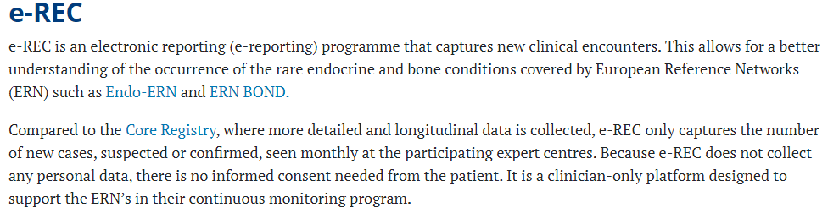
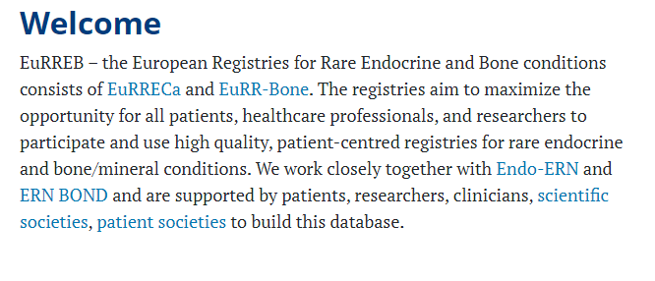
WP3 Evaluation
WP5 Registries
Important to enter data into e-REC for the continuous monitoring process.
Please feedback any challenges you are having.
https://eurreb.eu/registries/e-rec
www.eurreb.eu

Slide 4
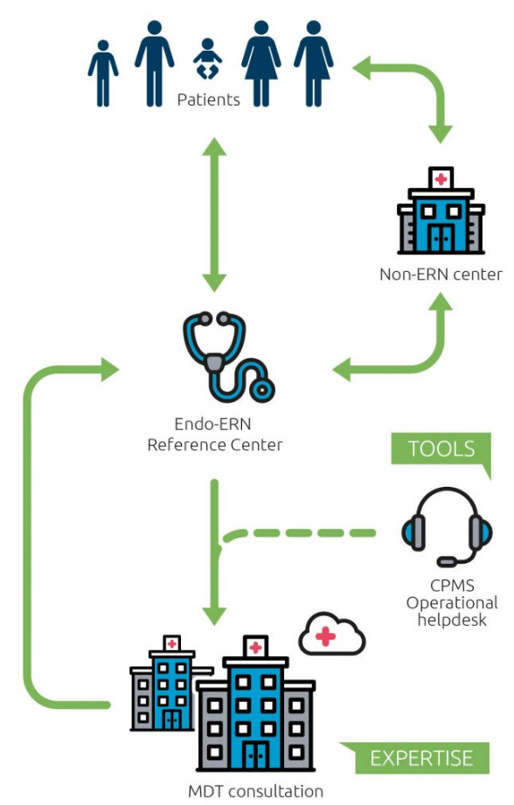
WP4 CPMS
Regular meeting dates:
MTG1, every 2 mths, 1st Tuesday at 15.00
  Tuesday 3rd Dec 2024
  Tuesday 4th Feb 2025
  Tuesday 1st April 2025
  Tuesday 3rd June 2025
Schedule your CPMS with the coordination office.
Useful links
CPMS - Endo-ERN
CPMS recurring meetings - Endo-ERN

Slide 5
WP6 Education & Training
Webinars
Each MTG is to host 2-3 webinars/year.
Webinars accredited by UEMS.
Scheduled:
16th Dec 2024 - Adrenoleukodystrophy (Athens, Christina Kanaka-Gantenbein)
5th March 2025 - Genotype-Phenotype correlations in CAH (Stockholm, Anna Nordenström/Svetlana Lajic)
To schedule:
Spring 2025 CAH – new findings (Athens, Lia Charmandari)
Spring 2025 Adrenocortical cancer (Munich, Matthias Kroiss)
Spring/autumn 2025 Pheochromocytoma (Magdeburg, Antje Redlich)MTG1/MTG4

Slide 6
On-going work
Other endorsed events & training updates:
  Clinical Exchange Program: Second call for applications for an exchange visit in 2025 open from 1 October – 30 November 2024. Clinical Exchange how to apply - Endo-ERN.
  7th TALENT meeting 2025 in Rome, Feb 12-13: Transition Adolescence and Young Adults – Endocrine disease management.
Joint actions:
MTG1 is involved in the Transition of Care working group.
Survey is under development and will be sent out to HCPs.
The group will meet during the TALENT workshop.
MTG1 and MTG7 will jointly develop care pathways for CAH within the JARDIN project.

Slide 7
WP7 Clinical Practice Guidelines & Clinical Decision Support Tools
Research/information you want to share?
Any other business from your reference center / HCP?
New projects:
Prenatal treatment of CAH – evaluation of cases in Europe via web-based protocols. Contact Svetlana Lajic Svetlana.Lajic@ki.se

Slide 8
WP8/9 Capacity building and best practice sharing for Ukraine
Any contacts with Ukrainian endocrinologists?

Slide 9





