Slide 1
MTG6 HCP meeting
Friday 8 November 2024
12:00 – 13:00 CEST
Nienke Biermasz, Evangelia Charmandari, Johan de Graaf, Diana Vitali
MTG6 chairs

Slide 2
Agenda
Update from chairs
WP1 – Coordination
WP2 – Dissemination
WP3 – Evaluation
WP4 – CPMS
WP5 – Registries, data management and analysis
WP6 – Education and training
WP7 – CPGs and CDSTs
A.O.B.

Slide 3
WP1 Management & Coordination
9th Endo-ERN General Assembly: Friday 9 and Saturday 10 May 2025, Copenhagen, Denmark (prior to Joint Congress of ESPE and ESE 2025)
Digital working environment for the chairs
MS Teams
MS SharePoint
If for any project, you need to use a shared folder for files, we can help you!
Questions?
Unmet needs?

Slide 4

WP2 Communication & Dissemination
New publications, materials or events to be endorsed/updated/disseminated
Please follow Endo-ERN at our socials
https://www.linkedin.com/company/rareendoern
https://www.facebook.com/rareendoern
https://www.youtube.com/@rareendoern
www.endo-ern.eu

Slide 5
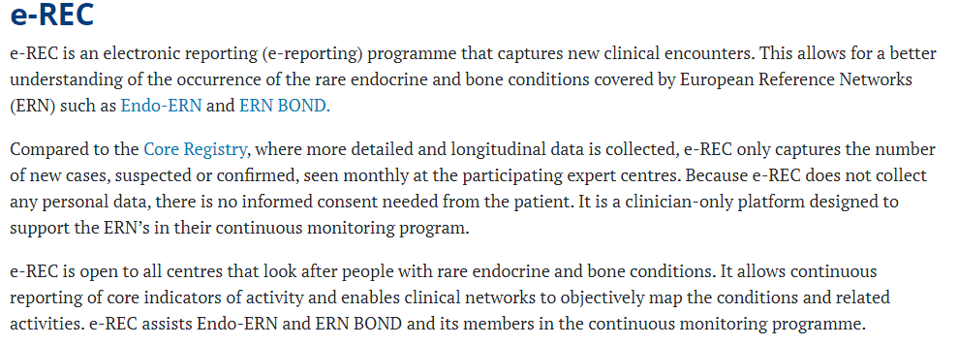
WP3 Evaluation
Continuous Monitoring
e-REC
Presumed deadline end of February 2025
HCP Performance System
First report available
Your attendance will improve your score (this meeting + GA)
https://eurreb.eu/registries/e-rec

Slide 6
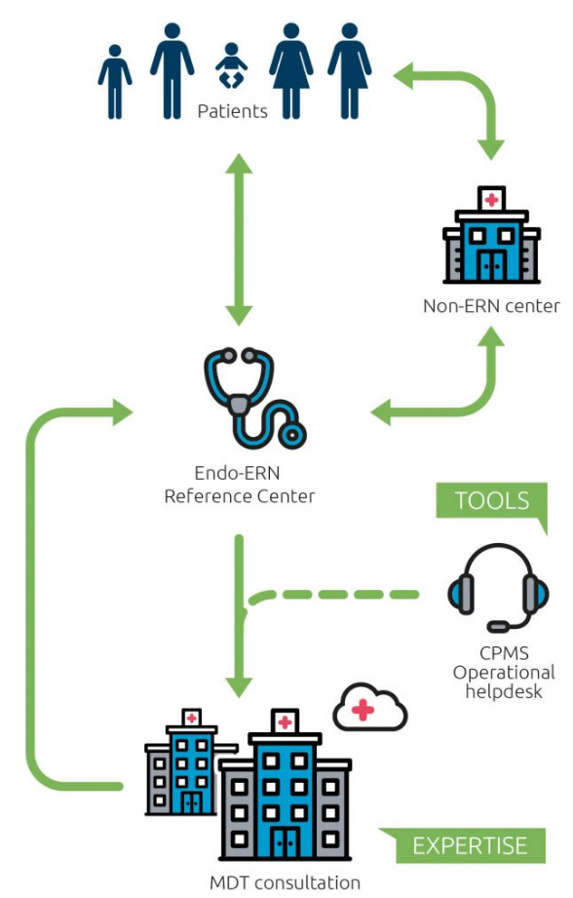
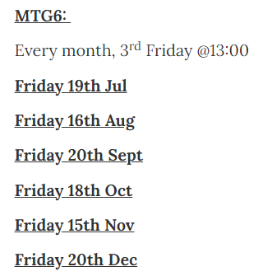
WP4 CPMS
New CPMS 2.0
Monthly meetings
Useful links
CPMS - Endo-ERN CPMS Recurring Meetings - Endo-ERN

Slide 7
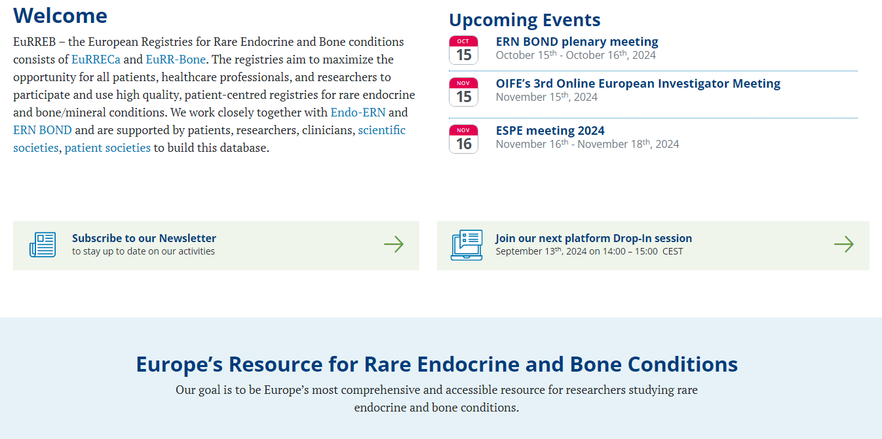
WP5 Registries
Any issues or barriers to using the EuRREB Core registry and the affiliated registries
www.eurreb.eu

Slide 8
WP5 Registries, data management and analysis
Modules for MTG6
Pituitary module
Other modules?
Two recently started research projects within Pituitary module → led by AUMC
Survey by ESE ESPE regarding Medicine Shortages (deadline November 25)
Possible survey on neurosurgical supplies shortages? (next slide)
Patient Journey project on craniopharyngiomas (next slide)
Future plan: Social and medical unmet need pituitary survey
Ideas for collaborative research questions?
Experiences?
Unmet needs?
Challenges?

Slide 9
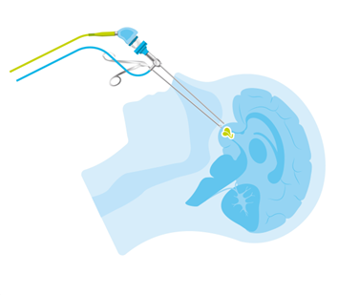
MDR and IVDR
Consequences of the Medical Device Regulation and the In Vitro Diagnostics Medical Regulation
Drills, endoscopic sleeves, navigational EM trackers and stylites and probable discontinuation of endoscopic equipment by Storz (effectively the monopolist)
Reported by both Dutch and British neurosurgeons
Does this apply for everywhere in Europe?
Concise survey together with neurosurgeons

Slide 10
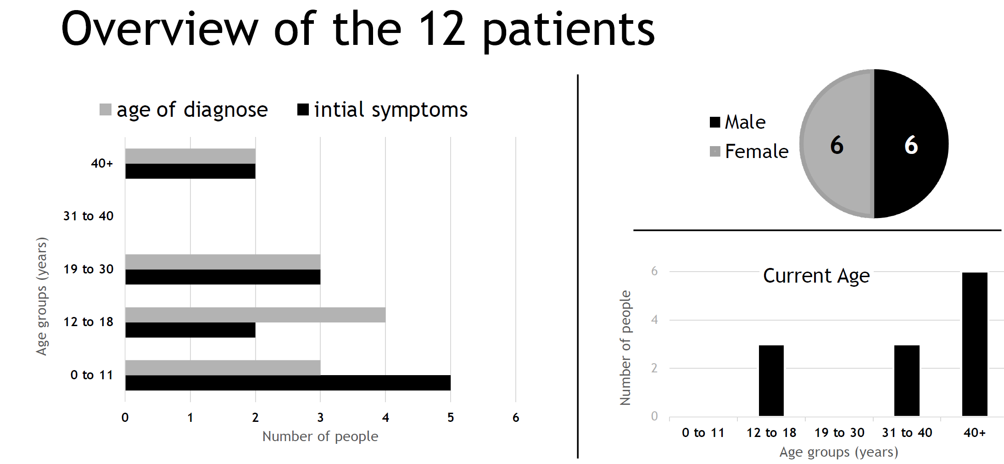
Patient Journey project on craniopharyngiomas
Creating a patient journey by means of interviews with patients and or carers in The Netherlands, Germany and the UK
Dutch patients have been interviewed
German patients have been invited
British Pituitary Foundation has been approached
Interviews with Health Care Professionals
Emphasis on the Health Journey (medical) and Life Journey (growing up/education/work/relationships/access to support)
Project is performed by a (self employed) communication specialist
Funded by a pharmaceutical company
The format of Eurordis on Patients Journeys will be used

Slide 11
WP6 Education and Training
Clinical Exchange Programme
Exchanges in 2024
Second call for applications for an exchange visit in 2025 open from 1 October – 30 November 2024
Clinical Exchange how to apply - Endo-ERN
Webinar Planning
Congenital hypopituitarism (Henrik Kristensen)
Cushing's (MTG1 MTG6 collaboration; WHO?)
Other ideas?

Slide 12
WP7 CPGs and CDSTs
Transition Working Group
Transition guideline
Special issue “Transition” in Endocrine Connections Deadline TODAY

Slide 13
WP8/9 Capacity building and best practice sharing for Ukraine
Any contacts with Ukrainian endocrinologists?

Slide 14
Thank you for your attendance!

Slide 15





